Slide 1

Online Library Management
TEAM 9
Lecturer: Huynh Trung Hieu .Ph.D.

Slide 2


Hello & welcome to presentation
N E X T
MEMBER: Nguyen Khoa - 14820 - @Khoas (leader)
Nguyen Van Khanh - 17096 - @Nomoreherozz
Trang Huu Hoang Do - 16014 - @Cl0u9
Huynh Duong Khai - 17529 - @r0s3nv3nsy
Hoang The Vinh - 17466 - @thevinhhoang02
LET’S GET STARTED

Slide 3





TOOLS Used
N E X T
DOCKER DESKTOP
VSCODE: C#,HTML
MYSQL
GITLab

Slide 4

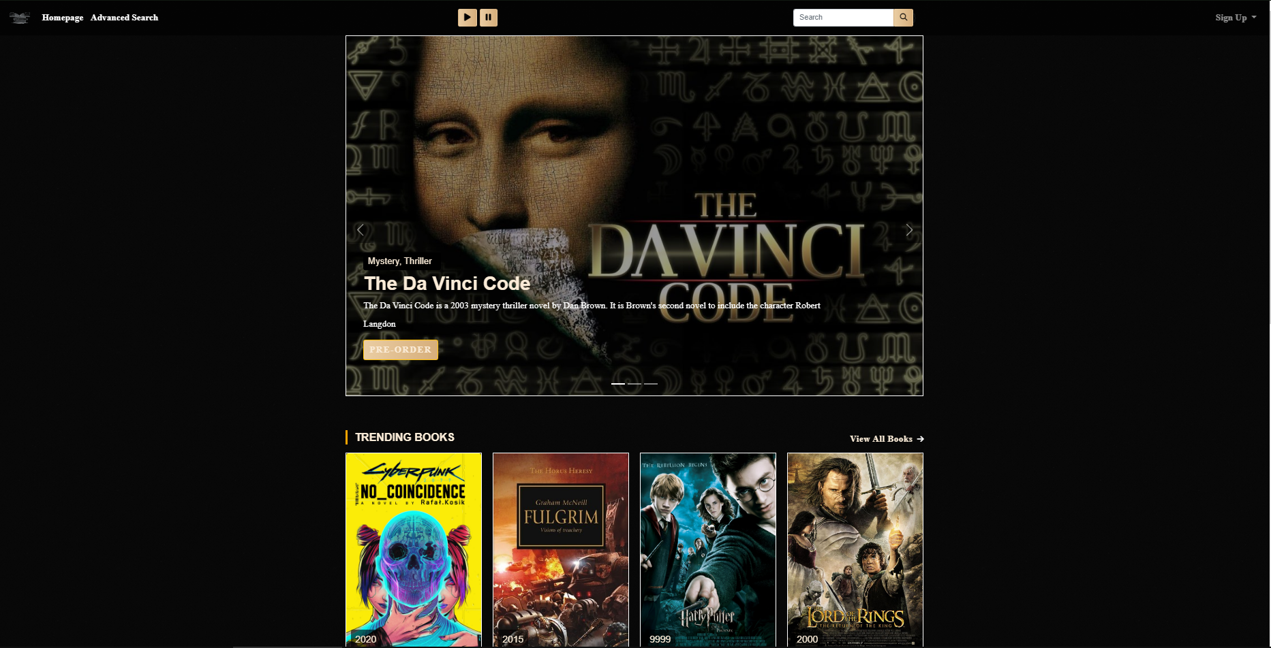
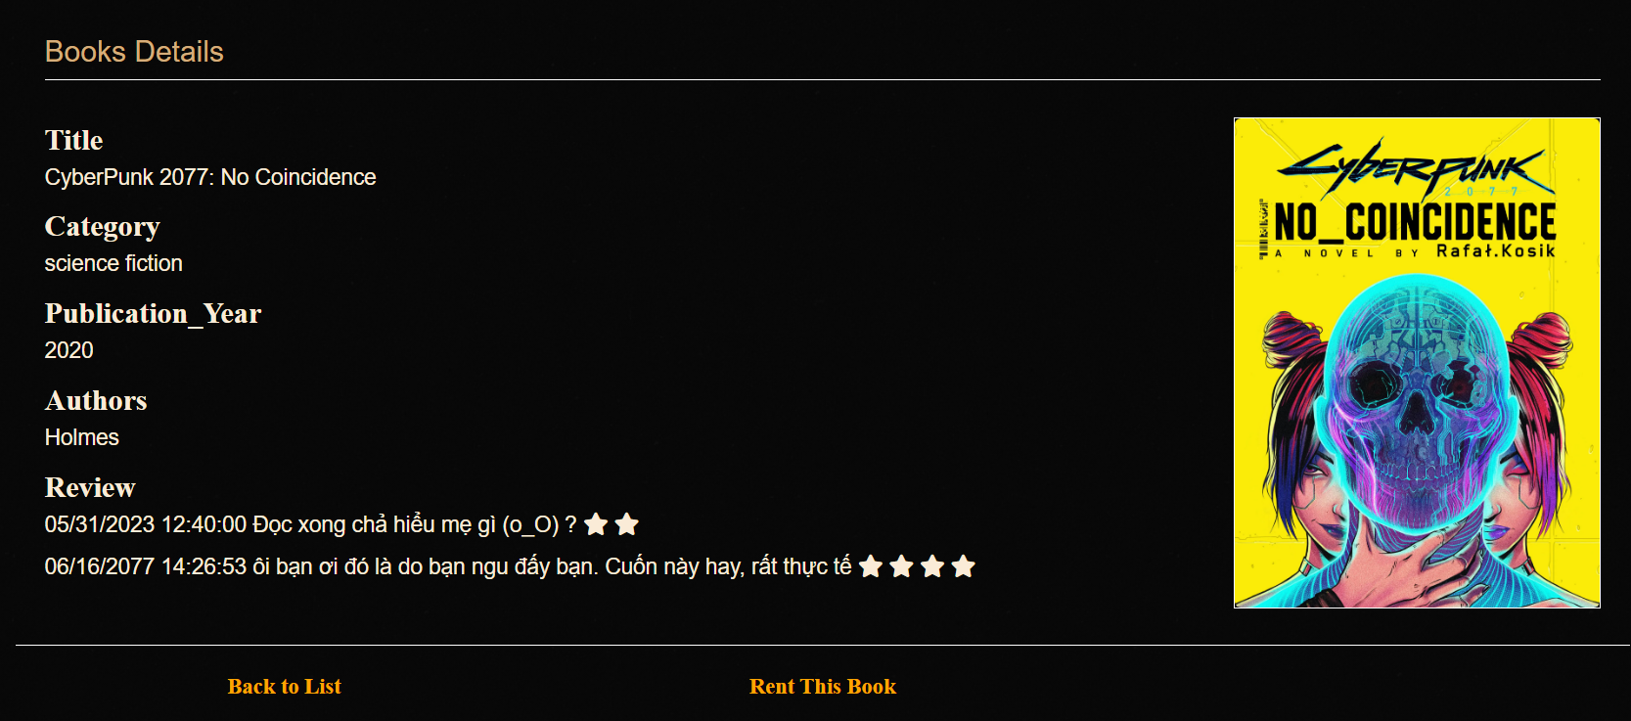
Front-end
HTML, C#
N E X T

Slide 5

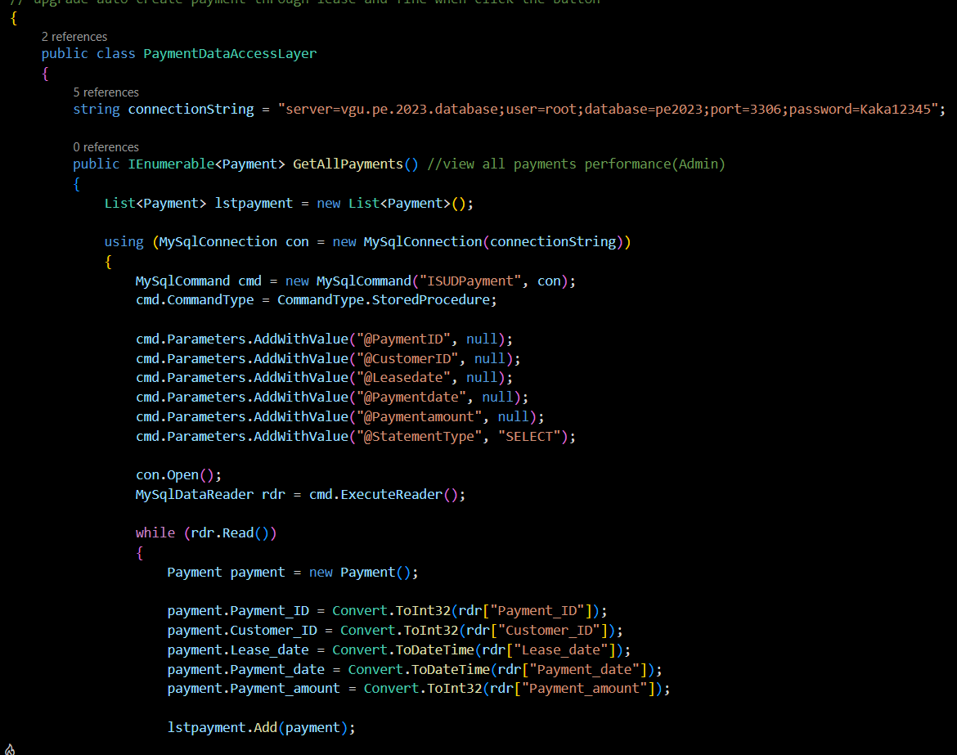
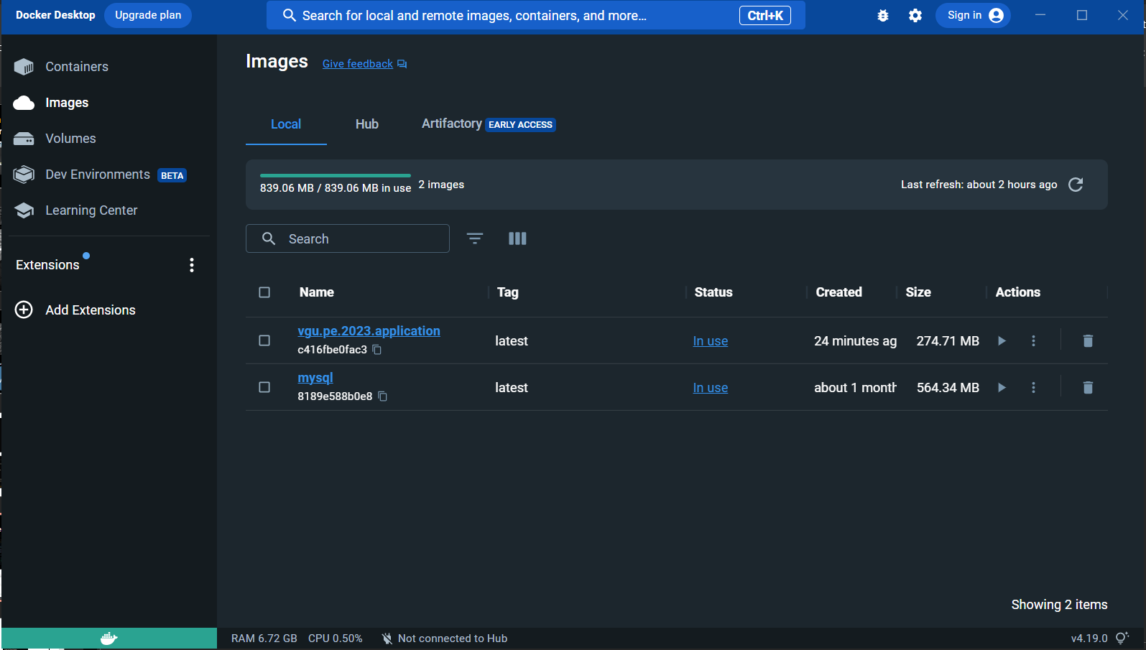
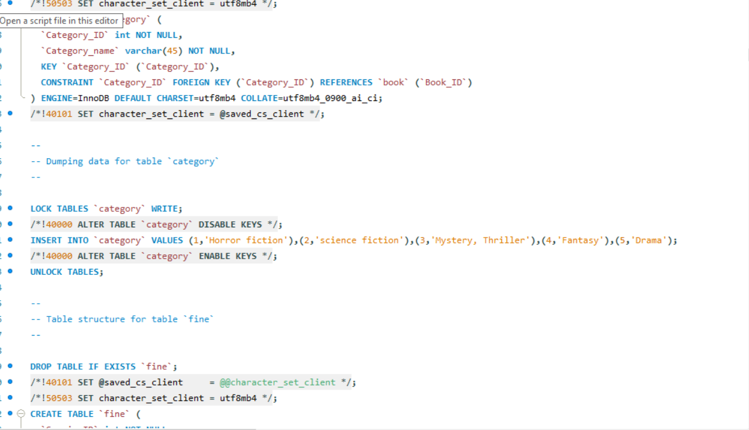
Back-end: C#, Docker, MySQL
N E X T

Slide 6
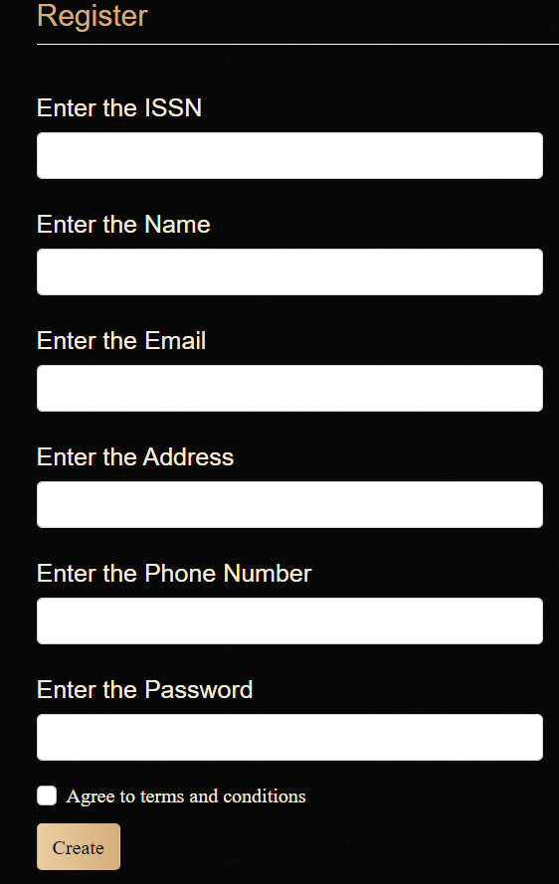
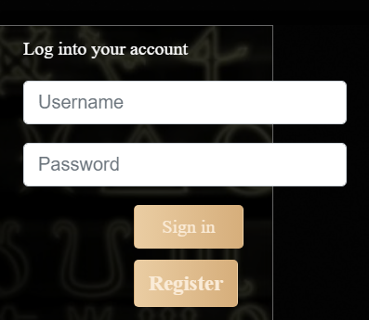

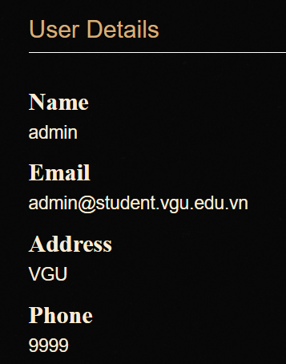
REGISTER
UserFunction
LOG IN
N E X T
VIEW USER DETAILS

Slide 7
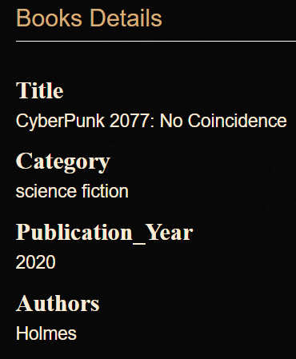

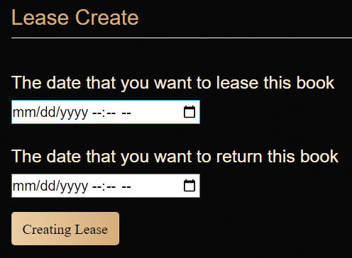
UserFunction
VIEW BOOK DETAILS
SEARCH
N E X T
LENT BOOKS

Slide 8

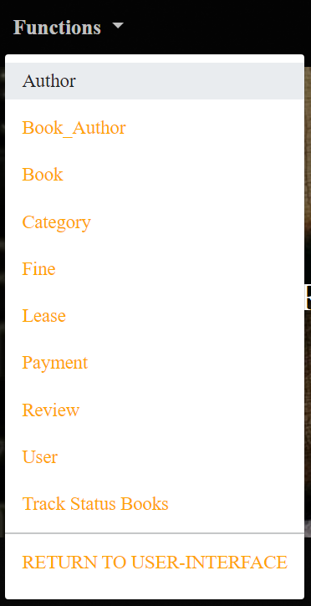
ADMIN Functions
N E X T

Slide 9


Thank you for listening
N E X T

